Slide 1

Breast Cancer Diagnosis Prediction with ML Models
DATASCI 223 – Spring 2025
Rishi Mukundan

Slide 2
Project Overview

Slide 3
Objective and Approach
Objective: Predict whether a breast tumor is malignant or benign using machine learning methods
Motivation: Early detection can improve treatment outcomes
Approach: Compare MLP, Logistic Regression, and XGBoost classifiers + compare how they respond to stress testing

Slide 4
Dataset Description
Source: UCI Breast Cancer Wisconsin Diagnostic Dataset
Rows: 569 samples
Features: 30 numerical features (mean, standard error, and worst of 10 characteristic measurements)
Target: Diagnosis (M = malignant, B = benign, encoded as 1/0)

Slide 5
Tools and Workflow

Slide 6
Specifications
Languages: Python
Libraries: scikit-learn, xgboost, tensorflow, pandas, joblib
Platform: Local development + Streamlit demo app
Environment: Python 3.12, virtual env highly recommended

Slide 7
Modeling Pipeline
Data preprocessing: encoding, scaling outcome
Model training:
Logistic Regression
MLP Neural Network (Keras)
XGBoost
Evaluation: Accuracy on test data with increasing levels of noise and outliers
Deployment: Streamlit web app for user interaction

Slide 8
Decisions and Trade-offs
Used standardized inputs across all models for fair comparison
Selected 3 models due to differing levels of complexity, interpretability, and scalability
Focused only on classification accuracy due to time constraints
Streamlit UI focused on simplicity for easier deployment

Slide 9
Challenges and Solutions
Running model training in parallel: calling functions from previous files led to a much cleaner workflow
MLP initial overfitting – utilized early stopping and learning rate scheduler
XGBoost low probability bug – analyzed many different angles including issues with scaler object – further analysis needed

Slide 10
Running the Code and Outputs

Slide 11
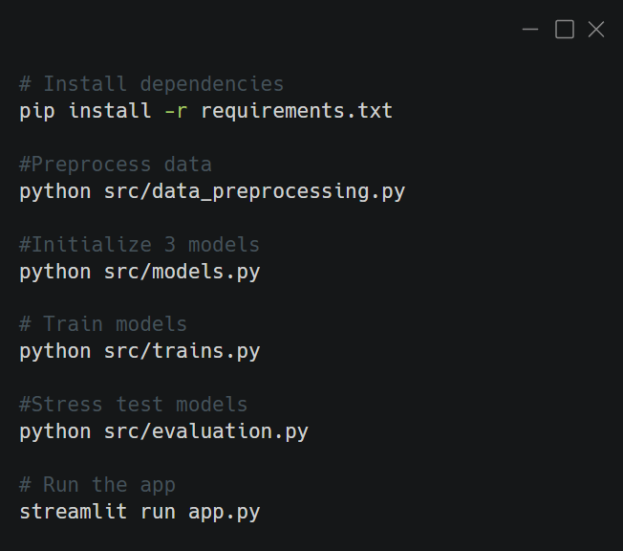
How to Run the Code
models.py outputs accuracy on test data + saves each model as object
evaluation.py outputs two graphs measuring model performance with increasing noise + outliers

Slide 12
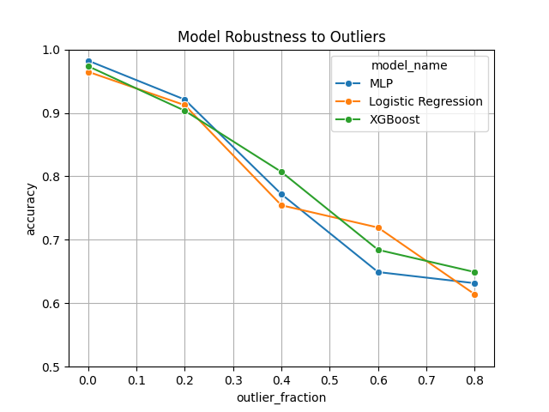
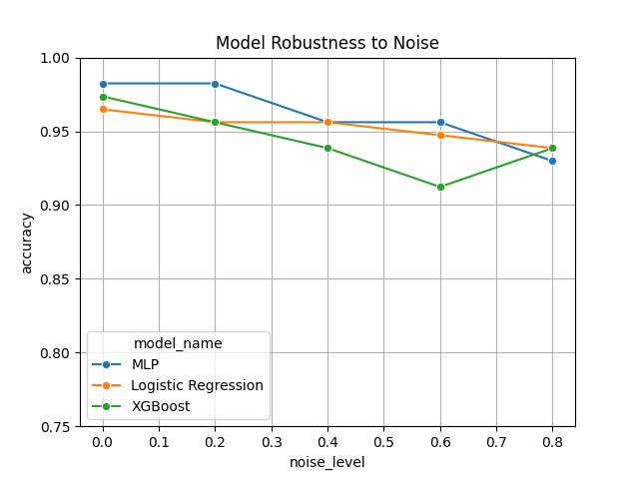
Stress Test Output
All 3 models performed very similarly with increasing levels of noise + outliers added to training dataset
Expected results – data is very well characterized due to easily separable classes (~97% accuracy with no stress)
Logistic Regression is preferred model due to simplicity without sacrificing predictive power

Slide 13
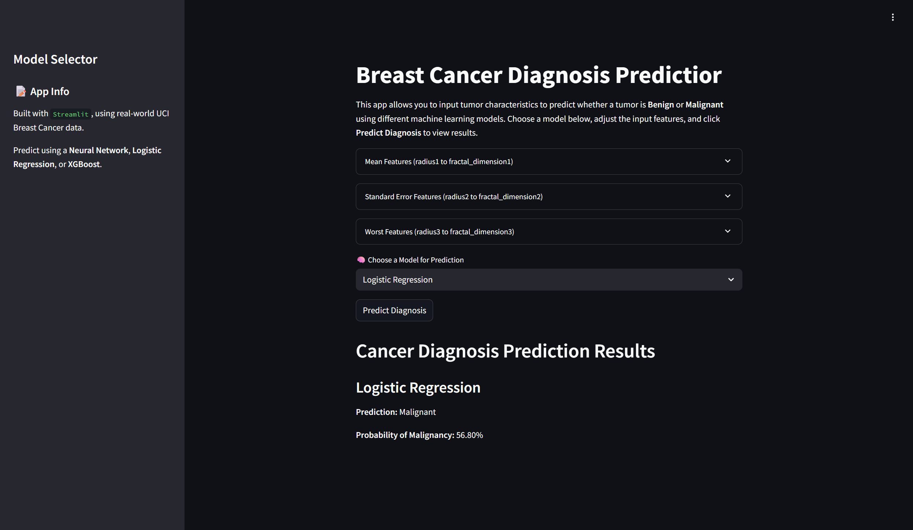
Streamlit App Demo Output
Input section (example values coded within app.py)
Output prediction with probability display

Slide 14
Future Work

Slide 15
Fixes and Future Goals
Debug XGBoost output
Tune hyperparameters to focus on metrics like F1 and AUC
Add SHAP/LIME interpretability
Convert demo into full web dashboard with user authentication

Slide 16
Citations
Wolberg, W., Mangasarian, O., Street, N., & Street, W. (1993). Breast Cancer Wisconsin (Diagnostic) [Dataset]. UCI Machine Learning Repository. https://doi.org/10.24432/C5DW2B.
Create an app. Streamlit Docs. (n.d.). https://docs.streamlit.io/get-started/tutorials/create-an-app

